Slide 1
Deliverable-3
Vegetation Analysis of
Digital Earth Africa Dataset
Members:
Krishna Vamsee Vangipurapu
Pallavi Shirodkar
Prasanna Kumar Boddupalli
Pratyusha Tummuri
Shashank Reddy Godala

Slide 2
Table of Contents
Introduction
Data Selection
About Data
Procedure
Feature Selection
Results and Evaluation
Future Scope

Slide 3
Introduction
“Digital Earth Africa transforms how earth observations can be applied to address some of the current pressing challenges coming in the path of Developing Africa.”
Africa is a vast continent with a diverse environment, including various types of biodiversity and homes with one of the fastest growing populations in the world. The population explosion is an additional strain on the natural resources in Africa, is also putting the environment under constant threat from climate change, environment degradation, natural calamities causing severe issues like food security and access to safe water- not only to the humans but also to the flora and fauna.
As a result, a new technological spirit is taking resolving these issues into hands but is hampered by the lack of actionable data. There are many types of data needed which are almost decision ready, for example rate of desertification, illegal mining activities locations, rate of poaching, total revenue from over agriculture, deforestation hotspots.

Slide 4
Dataset Selection
Digital Earth Africa Landsat Collection 2 Level 2 - Registry of Open Data on AWS
We as a team decided to take the Digital Earth Landsat Collection 2 level 2
Digital Earth Africa (DE Africa) provides free and open access to a copy of Landsat Collection 2 Level-2 products over Africa. These products are produced and provided by the United States Geological Survey (USGS). The Landsat series of Earth Observation satellites, jointly led by USGS and NASA, have been continuously acquiring images of the Earth’s land surface since 1972. DE Africa provides data from Landsat 5, 7 and 8 satellites, including historical observations dating back to late 1980s and regularly updated new acquisitions. New Level-2 Landsat 7 and Landsat 8 data are available after 15 to 27 days from acquisition. USGS Landsat Collection 2 was released early 2021 and offers improved processing, geometric accuracy, and radiometric calibration compared to previous Collection 1 products.

Slide 5
About Data
“Digital Earth Africa” will address this gap between innovative technologies and needed for actionable, structure, veritable data by using analysis ready data produced by Satellites by leveraging The Landsat series of Earth Observation satellites, jointly led by USGS and NASA, which have been continuously acquiring images of the Earth’s land surface since 1972.
Data type: Surface reflectance
Data timespan: March 2013 – present
Available regions: Entire African continent
Training data: Pixel data containing "crop" and "non-crop" labels (labelled as 1 and 0 in the geojson file, respectively) from Egypt.
Data preprocessing is the step where the data has been adjusted to make it more realistic, to get along with the actual data. There are plenty of ways and approaches to solve this data inconsistency, like by using the mean values to fill the missing data marked as NaN.

Slide 6
Procedure
Our goal is to answer the question "How is the crop/non-crop fraction of area changing over time in a given area?" using machine learning.
After loading the required packages and connecting to the Open Data Cube, these are the five primary steps in our journey of vegetation change detection.
Collect Training Data: Extracting the feature layers using geometrics from shapefile (geojson)
Inspect Training data: Inspect features using statistical methods.
Evaluate classifier: Evaluate accuracy using nested, k-fold cross validation.
Optimization and model fitting: use GridSearchCV to optimize hyperparameters and save the model on training data.
Classify satellite data: perform classification on number of small test locations to large regions

Slide 7
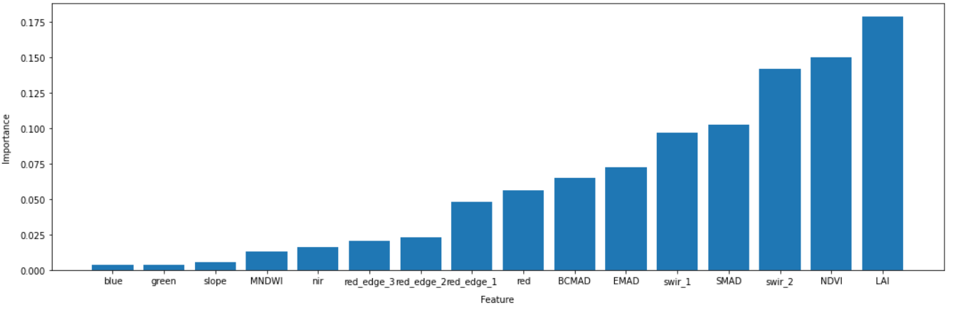
Feature Selection:
Using the random forest classifier, feature layer violin plots and principal component analysis ,we found out the importance of each feature, In this case, It was found that LAI, NDVI and swir_2 are the most important features.
Finding feature importance through Random Forest Classifier

Slide 8
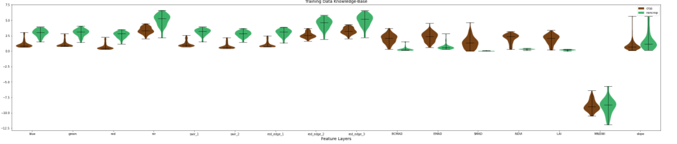
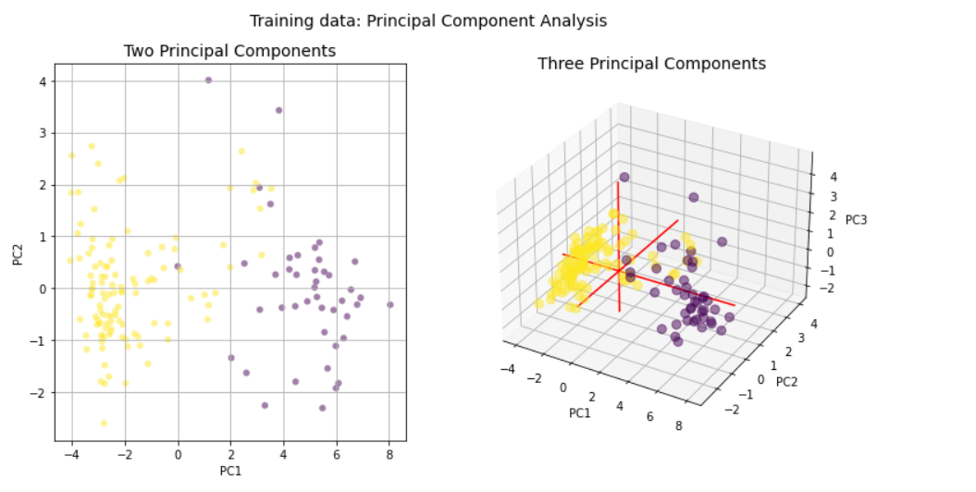
Feature Layer Violin Plots:
Principal Component Analysis:(2D and 3D Scatter Plots):

Slide 9

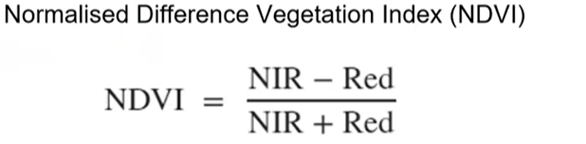
Feature Selection: (continued)
LAI: Leaf area index (LAI) is a dimensionless variable for characterizing vegetation canopies, defined as the one-sided area of green leaves (m2) per unit ground area (m2). It is landscape-scale variable comprising the sum of herbaceous and woody leaf area per unit land area.
NDVI: Normalised band indices values fall between -1 and 1 ,which gives a relative scale that allows for easier data analysis. Values of the index can be better compared between different points in the area of analysis, and across time periods.
NDVI > 0, or close to 1 = green vegetation
NDVI ≤ 0 = not green vegetation; water, soil, etc.
Swir_2: Short-wave infrared 2. This band is mainly helpful for discriminating among different types of rock formations. It can also be used to measures the infrared radiant flux (heat) amount emitted from the surfaces.

Slide 10
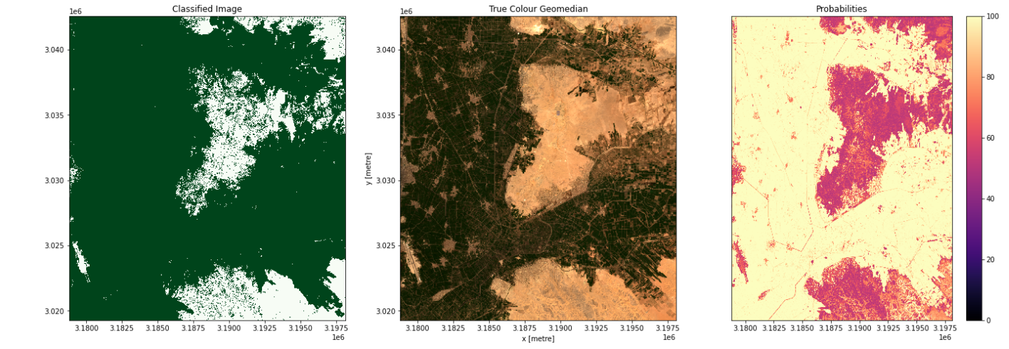
Results and Evaluation:
In the plots below you'll see on the left the classified image (green = crop, white = non-crop), in the centre a true-colour image of the region, and on the right an image of the prediction probabilities.
From the image, we can see that classifier has predicted the crop/non-crop portions correctly from the provided true-colour image and we can also see a prediction probability ranging from 0 to 100 on the right.

Slide 11
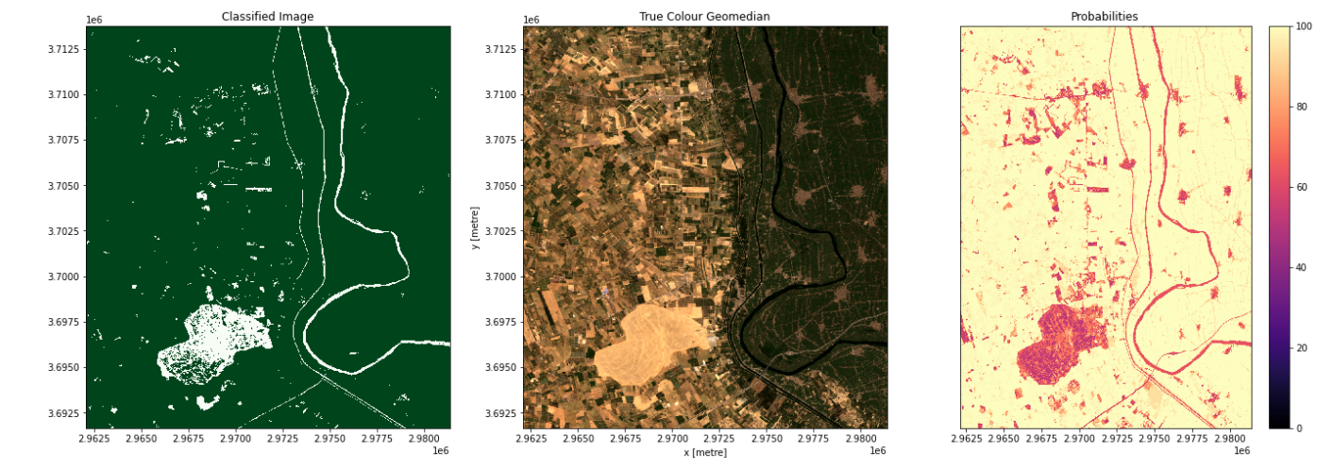
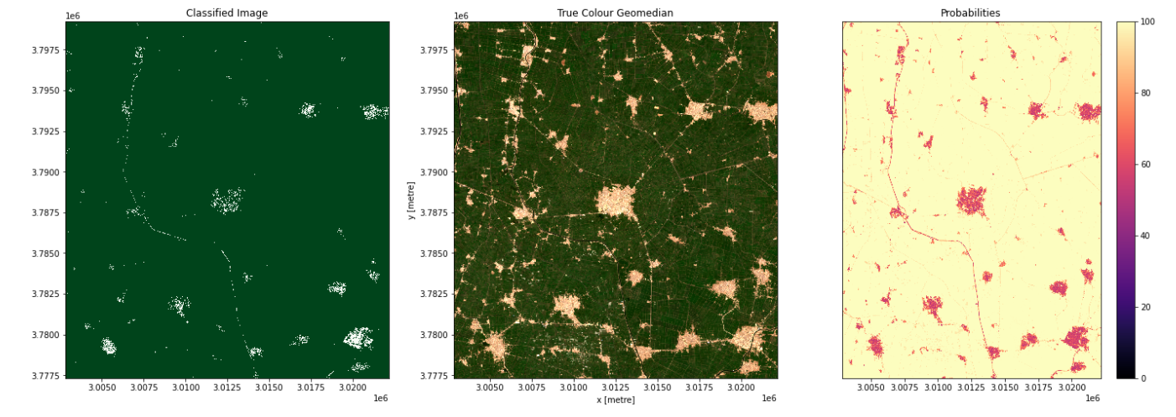

Slide 12
Future Scope
As a next level of analysis, we aim to map the effects of the flood on the vegetation on the flooded areas and also, conduct a predictive analysis on the areas which are prone to become barren as a consequence of subsequent floods. Along with it, the cumulonimbus cloud which has been the primal agent in the floods of Niamey, can also be detected by WOfS Data. We aim to target such data to predict if any such calamity can be foreseen without the need of Weather forecasting and high end technology.

Slide 13
Thank You

